Slide 1

Check-In Voting Site Station Guide
Revised August 2025

Slide 2
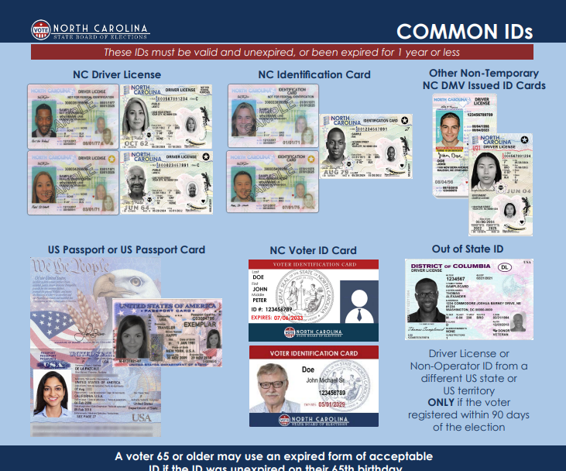
Acceptable Photo ID

Slide 3
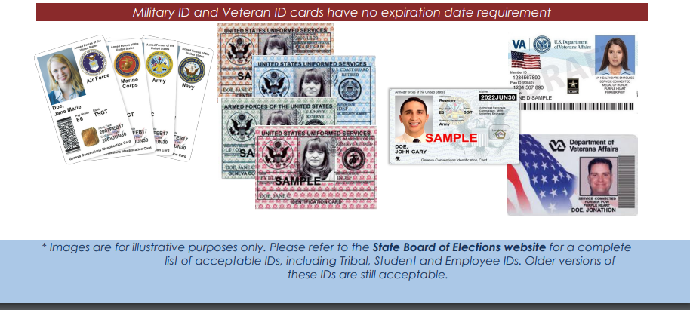

Slide 4
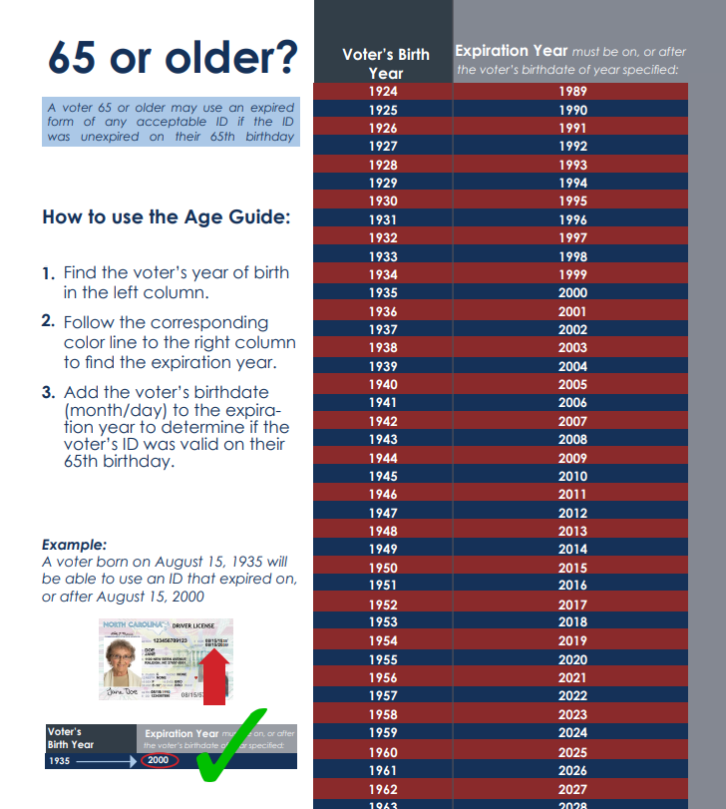

Slide 5
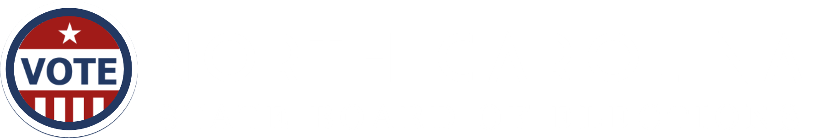
Check-in Procedures
1
Voter Greeting
2
Photo ID Review
3
Address Review
4
Voter Status Review
5
Party Affiliation Review-In Partisan Primaries Only
6
Determination of Eligibility and Voting Authorization
Check-in Station Steps

Slide 6

Step 1: Voter Greeting
If voter assistance is requested, determine eligibility
Ask for the voter’s name
Ask for the voter to show a photo ID

Slide 7
Step 1: Voter Greeting
If voter assistance is requested, determine eligibility
If a voter is in need of assistance, it must be requested. If a voter is accompanied when presenting to vote, an election official must determine if the voter wants assistance from that person. If the person is requesting assistance, the name, address, signature of the person assisting, and the time they entered the voting place, must be recorded on the voter assistant log. The voter may also ask for assistance from an election official. The election official does not need to complete the log.
Who may assist a voter?
A voter is entitled to assistance from a near relative: spouse, parent, child, brother, sister, grandparent, grandchild, stepparent, stepchild, mother-in-law, father-in-law, son-in-law, daughter-in-law
Who may receive voter assistance?
Disabled voters may receive the following forms of assistance from anyone except an agent of their employer or union representative:
entering the voting booth due to physical disability or blindness
assistance in marking the ballot due to physical disability, illiteracy, language difficulty, or blindness
Children under the age of 18 may accompany the voter and do not need to complete the log.
ADA requires that service animals are allowed in any polling place.
Step 1: Voter Greeting
Check-in Station| 2

Slide 8
Election officials should follow the script below to determine if a voter is entitled to assistance:
Ask the voter: “Is this person here to assist you?” If YES, go to question 2. If NO, instruct the person that they need to wait outside the voting enclosure. Ask the voter: “Is this person a near relative?” Refer to explanation of who can assist a voter. If YES, the voter may receive assistance. No further information is needed. If NO, go to question 3. Say: “A voter who needs assistance because the voter is blind, disabled, or unable to read, speak, or write English may receive assistance from a person of the voter’s choice. Do you need assistance for one of these reasons?” If YES, go to question 4. If NO, the voter is not entitled to receive assistance from someone who is not a near relative. If requested by the voter, an assistant, judge, or chief judge may assist the voter. Ask the voter: “Is this person your employer, employer’s agent, officer of your union, or agent of your union?” If YES, the person may not assist the voter. The voter may select someone else to assist him or her. If requested by the voter, an assistant, judge, or chief judge may assist the voter. If NO, the voter may receive assistance. Ensure the voter assistant log is completed.
entering the voting booth due to physical disability or blindness,
assistance in marking the ballot due to physical disability, illiteracy, or blindness
Step 1: Voter Greeting
Check-in Station | 3

Slide 9
Ask for the Voter's Name
The voter's statement of their name must be heard by the election official. If the voter's statement is difficult to hear or discern, an election official may ask the voter to repeat the name more slowly or loudly, or to spell any portion of the name.
If a person is unable to state their name because of an impairment, the election official may make reasonable accommodations including asking the voter to write their name.
The voter may be able but unwilling to state their name. The official will explain that the law requires voters to state their name aloud. If the voter continues to refuse to cooperate with the election official at the check-in station, the official will arrange for the voter to speak with the Chief Judge.
Step 1: Voter Greeting
Check-in Station | 4

Slide 10
Ask the voter to show a photo ID
NC law requires a voter to show an acceptable form of photo ID or to sign a form claiming an exception (the Photo ID Exception Form).
The following circumstances require the check-in election official to inform the voter of the options for voting a provisional ballot without an ID, complete a Help Station Referral Form, and refer the voter to the Help Station:
If a voter says they forgot their photo ID, ask them if they can easily retrieve it. If they cannot, they must be informed of both options for voting a provisional ballot without a photo ID: (1) Exception Form or (2) bring ID to the county board office.
If a voter does not have a photo ID due to some difficulty that prevents the voter from presenting a photo ID (a “reasonable impediment”).
If a voter does not have a photo ID due to a religious objection to being photographed.
If a voter simply refuses to show a photo ID.
If a voter does not have a photo ID because they are the victim of a recent natural disaster.
The election officials at the Help Station can provide the voter with additional details for the two options to vote a provisional ballot when a voter is unable to show a photo ID.
Step 1: Voter Greeting
Check-in Station | 5

Slide 11
Step 2: Photo ID Review
Inspect the photo ID
Determine if the photo ID is an acceptable type
Determine if the photo ID meets expiration requirements

Slide 12
Inspect the photo ID
Once the voter has presented a photo ID, the election official must determine if the ID is an acceptable type for voting and meets expiration requirements.
The check-in election official should use the current List of Acceptable Forms of Photo ID provided by the State Board of Elections and the Common ID Flyer to confirm that the photo ID is an acceptable type of ID.
If a voter presents a photo ID for voting that is not on the list of acceptable photo IDs, the official must ask the voter if they have another photo ID that is on the list.
If the voter does not have another photo ID: the official must inform the voter of the options for voting a provisional ballot without an ID, complete a Help Station Referral Form, and refer the voter to the Help Station.
Step 2: Photo ID Review
Check-in Station | 7

Slide 13
Determine if the photo ID meets expiration requirements
Some photo IDs must be unexpired or expired for one year or less. Use the current list of Acceptable Photo IDs for Voting in to confirm if a photo ID must meet expiration requirements.
For voters 65 years old and older, the expiration requirements are not applicable if the photo ID was unexpired on the day the voter turned 65 years old. Use the Age Guide on the back of the Common ID Flyer to confirm when the voter turned 65 years old.
For student and government-employee photo IDs, once the State Board approves a school’s or government’s photo ID card, older photo IDs from the same entity that are still in circulation are valid for voting, so long as the voter’s ID is unexpired. A photo ID card that has no expiration date is not expired.
If a voter presents a photo ID that does not meet expiration requirements, the check-in official must ask the voter if they have another photo ID that is on the list. If the voter does not have another photo ID: the check-in election official must inform the voter of the options for voting a provisional ballot without an ID, complete a Help Station Referral Form, and refer the voter to the Help Station.
Step 2: Photo ID Review
Check-in Station | 8

Slide 14
Evaluation of Photo and Name
Determine if the photograph on the photo ID reasonably resembles the person presenting to vote
Determine if the name on the photo ID is the same as or substantially equivalent to the name on the voter list
Make a final determination that the photo ID meets all requirements

Slide 15
The check-in election official must decide if the person in the photo on the photo ID reasonably resembles the voter presenting to vote. This means the voter’s appearance is similar to the photo, and an ordinary person would conclude that the photo is more likely than not a photo of the person presenting the ID. The official must decide this based on all the information the official has. The official must keep in mind that there are many reasons that a person’s appearance could change.
Determine if the photograph on the photo ID reasonably resembles the person presenting to vote
The purpose of the photo ID requirement is to confirm the person presenting to vote is the registered voter on the rolls. You are not matching addresses. When determining reasonable resemblance, you are only confirming that the photo on the ID reasonably resembles the person checking in.
Step 2: Photo ID Review
Check-in Station | 10

Slide 16
Determine if the photograph on the photo ID reasonably resembles the person presenting to vote
A voter’s appearance may have changed since their photo ID was issued because of many reasons, including changes in:
age
weight
hair features and styling, including changes in length, color, hairline, or use of a wig or other hairpiece
facial hair
complexion or skin tone
cosmetics including piercings or tattooing
apparel, including the presence or absence of eyeglasses or contact lenses
characteristics arising from a medical condition, disability, medical treatment (e.g., plastic surgery), or aging
gender transition
photographic lighting conditions or ID printing quality
Check-in Station | 11
Step 2: Photo ID Review

Slide 17
To make this determination, the check-in election official cannot require the voter to present additional documentation and cannot require the voter to removal apparel, including face coverings.
Although not required, the voter may still choose to present additional documentation or remove a face covering.
If the voter’s face is covered enough that the check-in election official cannot make this determination, then they must tell the voter that the face covering is preventing them from determining that the photo on the ID is the voter’s photo. The check-in official must then offer the voter the option to briefly remove the face covering, which can also be done in a less-crowded part of the voting place or outdoors. If the voter chooses to not remove the face covering, then the check-in official must enter a challenge by completing the Help Station Referral Form. The voter should then be referred to the Help Station for the judges to conduct a challenge hearing.
Check-in Station | 12
Step 2: Photo ID Review

Slide 18
Determine if the name on the photo ID is the same as, or substantially equivalent to, the name on the voter list
After reviewing the photograph on the ID, the check-in official should next search for the voter’s name in the pollbook. If the voter’s name cannot be located on the voter list, here are a few suggestions:
Ask the voter to spell their name or use the name displayed on the photo ID
Ask the voter if their name has changed
Ask the voter if their name is hyphenated
Ask the voter if their name has a suffix (Jr., Sr., etc.)
Perform a wildcard search with last name (electronic pollbook)
Perform a search by voter’s residential address (electronic pollbook)
Perform a search by date of birth (electronic pollbook)
If the check-in election official is unable to locate the voter record on the voter list, the official must complete a Help Station Referral Form and refer the voter to the Help Station.
Step 2: Photo ID Review
Check-in Station | 13

Slide 19
Determine if the name on the photo ID is the same as, or substantially equivalent to, the name on the voter list
The official will make this determination based on all the information available. This includes any explanation or documents voluntarily offered by the voter. This information must be considered in the light most favorable to the voter.
If differences in the name are attributable to a reasonable explanation, then the name on the photo ID is substantially equivalent to the name in the registration record.
Step 2: Photo ID Review
Check-in Station | 14

Slide 20
Make a final determination that the photo ID meets all requirements
After reviewing the photograph and the name on the photo ID, the check-in official must make a final determination that the photo ID meets all requirements.
If the check-in election official determines that the photo ID meets all requirements, then the official should return the photo ID to the voter and proceed to the next step in the check-in process.
Election officials must be careful not to consider the address listed on a photo ID when determining whether the photo ID meets all requirements
If the official is unsure that the photo depicts the voter or that the name is substantially equivalent, the official may consider additional information on the face of the ID, if needed, to confirm the person presenting to vote is the registered voter on the rolls.
Step 2: Photo ID Review
Check-in Station | 15

Slide 21
If the official finds that the photograph on the photo ID does not bear a reasonable resemblance to the person presenting to vote, or the name of the ID is not the same as or substantially equivalent to the name on the voter record, then the official must tell the voter the reasons the election official made that determination and invite the person to provide any other acceptable photo ID they may have.
If the voter does not offer another type of acceptable photo ID, the check-in official must enter a challenge by completing the Help Station Referral Form. The voter should then be referred to the Help Station for the judges to conduct a challenge hearing.
Step 2: Photo ID Review
Check-in Station | 16

Slide 22
Step 3: Address Review
Ask the voter to state their residential address

Slide 23

Ask the voter to state their residential address
A voter must state aloud their legal voting residence, so the election official can hear it. If the voter is difficult to hear, the official may ask the voter to repeat the address more slowly or loudly, or to spell any portion of the address. The stated address must be used to ensure that the election official has identified the correct voter in the voter list.
A voter’s voting residence is the address where the voter has resided for at least 30 days as of the date of the election.
If a person is unable to clearly state their address because of a disability or face covering, the election official may make reasonable accommodations, including asking the voter to write the address. A voter who is unable to state their address may receive assistance in stating their address or may point to their address on a document including on their photo ID.
In some circumstances, a voter may have difficulty remembering their address. This may occur due to age or disability. Every reasonable opportunity must be given to the voter to assist in identifying the correct address. A voter who, due to a disability, is unable to remember their address may receive assistance in stating their address or may point to their address on a document including on their photo ID.
Step 3: Address Review
Check-in Station | 18

Slide 24
The voter may be able but unwilling to state their address. The official will explain that the law requires voters to state their address aloud. If the voter continues to refuse, the official will arrange for the voter to speak with an election judge.
If the address on record is different than the stated address:
Confirm that you located the correct voter record, according to the voter’s name
If you have the correct voter record, ask voter if they have moved
If voter indicates they have moved, ask voter for their previous address
If the previous address matches the address in the voter’s record, ask the voter for the date of the move
If the date of the move is less than 30 days before election day, the voter is eligible to vote a ballot based on the previous address
If the date of the move is 30 or more days before election day, follow the Unreported Move procedures
Remember: the voter’s residential address does not have to match the address on their photo ID.
Step 3: Address Review
Check-in Station | 19

Slide 25
Step 4: Voter Status Review
Determine the voter’s status

Slide 26
Determine the voter’s status
The election official must check the voter’s record to determine if there are voter status issues that require the voter to provide additional information or documentation before a regular ballot can be issued to the voter.
Active
The voter is registered to vote in the county and there are no known address issues.
Inactive
The voter is registered to vote in the county, but the county board of elections is unsure of their correct physical or mailing address.
Inactive – DL/SSN Update
The voter is registered to vote in the county, but the county board of elections is required to obtain the voter’s DL/SSN number to complete their registration.
Voters who are part of the Registration Repair Project will be flagged with this status and must vote provisionally
ID Required
The voter is a first-time voter and is required to show a HAVA ID before voting
If the voter does not show a HAVA ID then they must vote provisionally
Step 4: Voter Status Review
Check-in Station | 21

Slide 27
Inactive
A Verify Address (printed pollbook) or Inactive (SOSA/OVRD) indicates the voter is registered to vote in the county, but the county board of elections is unsure of their correct physical or mailing address.
Voters who are inactive on a county’s voter registration list are still registered and are entitled to vote. An inactive voter’s proper voting address is the address in the county where the voter has resided for at least 30 days as of the date of the election.
If a voter is inactive when presenting to vote, they are not required to show any document or ID that proves a current address. The voter must simply affirm their current address, orally or in writing.
If the voter confirms the same address that is on the voter record, ask whether the voter is able to receive mail there, and if not, whether they have an alternative mailing address
If the voter provides a new address in the county and is voting during early voting, update the voter’s address and provide the appropriate ballot, if applicable
If the voter provides a new address in the county and is voting on election day, follow the procedures for Unreported Moves
This is not the process for Inactive - Registration Repair Status. DL/SSN-Provisional Only (printed pollbook) and DL/SSN Update Record (SOSA/OVRD) will indicate the Registration Repair status.
Step 4: Voter Status Review
Check-in Station | 22

Slide 28
Inactive – DL/SSN Update (Registration Repair)
If the record indicates that the voter is subject to Registration Repair, the voter will be required to vote a provisional ballot.
Complete a Help Station Referral Form and refer the voter to the Help Station.
DL/SSN Update Record (SOSA/OVRD)
DL/SSN Provisional Only (printed pollbook)
Mark Help Referral form reason “Any Other Issue” and indicate the issue as “Registration Repair.”
Under federal law (52 U.S.C. 21803) and North Carolina law (G.S. 163-82.4), when a person registers to vote, they must provide their driver’s license number or, if they don’t have one, the last four digits of their social security number. This information is used to verify the person’s identity.
If you see this status on a voter’s record it indicates that based on a review of county records, we have not been able to confirm that the voter provided their driver’s license number or the last four digits of their social security number when registering to vote or mark on the registration form that they do not have either of those numbers.
As a result of a state court order, this means the voter is required to vote a provisional ballot so that we can receive this information to complete their registration before counting their ballot.
Step 4: Voter Status Review
Check-in Station | 23

Slide 29
ID Required
An “ID required” designation indicates that this is a first-time voter who did not provide verifiable identification with their voter registration. The requirement for first-time voters to show this ID is a requirement of the Help America Vote Act (HAVA) of 2002 and state law (G.S. § 163-166.12).
This is separate from the NC photo ID requirement
Acceptable forms of HAVA ID include:
•A current and valid (unexpired) photo identification
OR
• A physical or electronic copy of one of the following documents that show the name and address of the voter: a current utility bill, bank statement, government check, paycheck, or other government document.
First-time voters who are required to show HAVA ID are notified of this requirement in advance by their county board of elections.
Reminder: an acceptable ID used for photo ID can also be used for HAVA ID if it is current and valid.
Step 4: Voter Status Review
Check-in Station | 24

Slide 30
No Ballot
Even if a voter is registered in the county, the voter may not be eligible to participate in the election, or may not be in the pollbook where they present to vote. An election official will need to determine if the voter has an eligible ballot style for the election.
A person’s eligibility to participate in an election is based on these factors:
Residence
Age
Party Affiliation (partisan primary only)
If the voter is registered to vote in the county (Active or Inactive) but the voter does not appear to have an eligible ballot style, complete a Help Station Referral Form and refer the voter to the Help Station.
If the voter is not in your printed pollbook, the election official should always complete a Help Station Referral Form and refer the voter to the Help Station.
Step 4: Voter Status Review
Check-in Station | 25

Slide 31
Absentee/Already Voted
If the record indicates that the voter has already cast a ballot, the election official should
reconfirm that the correct voter record has been located in the voter list. If it is determined to be the correct voter record, the election official should explain that the voter may cast a provisional ballot that will allow the county board of elections to research the matter.
If the voter indicates that they have not already cast a ballot in the election, complete a Help Station Referral Form and refer the voter to the Help Station.
Removed/Denied
The voter is no longer considered to be registered to vote in the county. Voter may only vote a provisional ballot.
Complete a Help Station Referral Form and refer the voter to the Help Station. Please note that if this is during the early voting period, voters can same-day register.
Step 4: Voter Status Review
Check-in Station | 26

Slide 32
Step 5: Party Affiliation Review
This step is for partisan primaries only
Ask the voter to state their party affiliation

Slide 33
Ask the voter to state their party affiliation (partisan primaries only)
In a partisan primary, election officials must ask each voter to state their political party affiliation.
Unaffiliated voters must state the party primary they wish to vote in or choose to vote a nonpartisan ballot.
The following parties are recognized in North Carolina: Democratic, Green, Libertarian, and Republican.
If a voter requests a primary ballot for a party that is different than the party on their voter record, the election official must explain that the voter is not eligible for that ballot style but may vote that ballot provisionally. Complete a Help Station Referral Form and refer the voter to the Help Station.
If a voter requests a primary ballot for a party that does not have a primary, the election official must explain that the party does not have a primary. If the voter is an unaffiliated voter, they may choose to vote in a different party’s primary or a nonpartisan ballot, if available. If the voter’s party does not have a primary, they may only vote a nonpartisan ballot, if available.
Step 5: Party Affiliation Review
Check-in Station | 28

Slide 34
Step 6: Determine Voter Eligibility and Voting Authorization
Make a final determination if voter is qualified and eligible to vote in the election
Review the vote authorization document

Slide 35
Make a final determination if voter is qualified and eligible to vote
If the election official determines that voter is qualified and eligible to vote:
State the voter’s name, residential address, and party (only for a primary) to confirm the voter is duly registered to vote.
Issue the voter a vote authorization document.
Review the vote authorization document
Once the vote authorization document is prepared or generated, the election official must review key elements on the form with the voter. The election official must point to the following on the form and prompt the voter to review the form:
Name
Address
Party Affiliation (if voting in a partisan primary)
Ballot Preference (if voting in a partisan primary)
Step 6: Determination of Voter Eligibility and Voting Authorization
Check-in Station | 30

Slide 36
The election official must also review the voting eligibility statements with the voter. By signing the form, the voter certifies they:
Are registered to vote in the county and shall have resided at the address on the form for 30 days immediately prior to the election
Are a U.S. citizen
Are at least 18 years of age or will be by the date of the general election.
(For a partisan primary election only) are registered with the party noted on the form, or if they are unaffiliated that they will receive the noted ballot style
Understand that it is a felony to vote more than one time in an election
Are not currently serving a felony sentence (including any probation, post-release supervision, or parole)
After the voter has reviewed the form, the voter must be asked to sign the form. The election official will initial or sign the vote authorizing document. The voter should then be directed to take the form to the Ballot Station.
If a voter decides to leave the polling location without voting, notify the chief judge, complete an incident report, and follow the supply return procedures for your county.
Step 6: Determination of Voter Eligibility and Voting Authorization
Check-in Station | 31

